Slide 1

SMART CONTRACTS & CONTRACT LAW:
UNFORESEEN EVENTUALITIES
Bill Marino Cornell Tech CS M.Eng. & JD
May 18, 2016

Slide 2
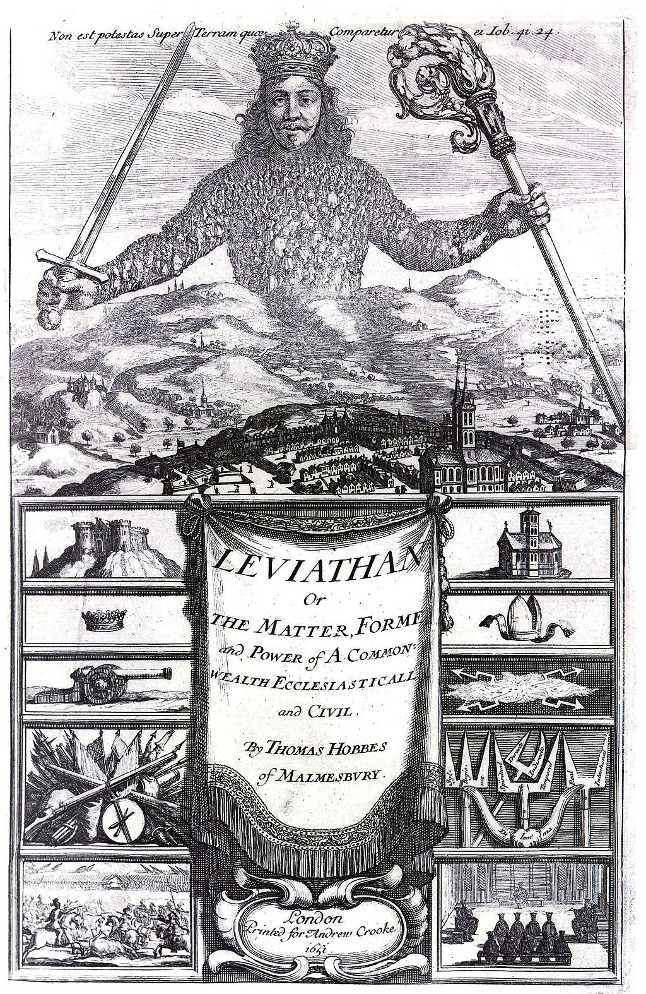
Notes:
Let’s start with a pop quiz. Does anyone know which book this frontispiece -- it’s not a cover, it’s a frontispiece -- belongs to?

Slide 3
Notes:
Leviathan by Thomas Hobbes, published in 1651.

Slide 4
If a covenant be made wherein neither of the parties perform presently, but trust one another, in the condition of mere nature … upon any reasonable suspicion, it is void: but if there be a common power set over them both, with … force sufficient to compel performance, it is not void.
— Thomas Hobbes, Leviathan (1651)
Notes:
At least as far back as this book, it has been recognized that the primary purpose of contract law was to deter…

Slide 5
OPPORTUNISTIC
BREACH
Notes:
Opportunistic breach of agreements.

Slide 6
The basic idea of smart contracts is that many kinds of contractual clauses … can be embedded in the hardware and software … in such a way as to make breach of contract expensive (if desired, sometimes prohibitively so) …
— Nick Szabo, Smart Contracts: Building Blocks for Digital Markets (1996)
Notes:
Turns out that smart contracts also aim to deter opportunistic breach through the use of technology. This has idea has been recognized as far back as the seminal writings on smart contracts. So, in this sense, the aims smart contracts dovetail with the goals of contract law. But there’s another aspect of contract law that doesn’t get discussed as much when it comes to smart contracts and that is…

Slide 7
THE NEED TO
MODIFY OR UNDO CONTRACTS
IN LIGHT OF
UNFORESEEN EVENTUALITIES
Notes:
...the need to occasionally modify or even undo contracts in light of unforeseen eventualities.

Slide 8
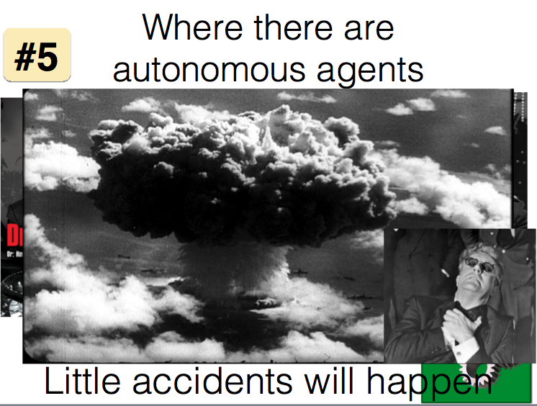
Notes:
You may recall from Ari’s opening address yesterday that the fifth grand technical challenge was to deal with unforeseen eventualities once smart contracts are deployed. Contract law already has well-developed tools for dealing with such eventualities. If we are going to make smart contracts viable and also harmonize them with existing institutions, then it would be advantageous to think about which of those tools we might import from contract law. Let me give you an example of one of these contract law tools in action.

Slide 9
Krell v. Henry (1903)
Notes:
Krell v. Henry is a seminal contract law case. If you went to law school, you surely read it first year. For everyone else, the facts are these:

Slide 10
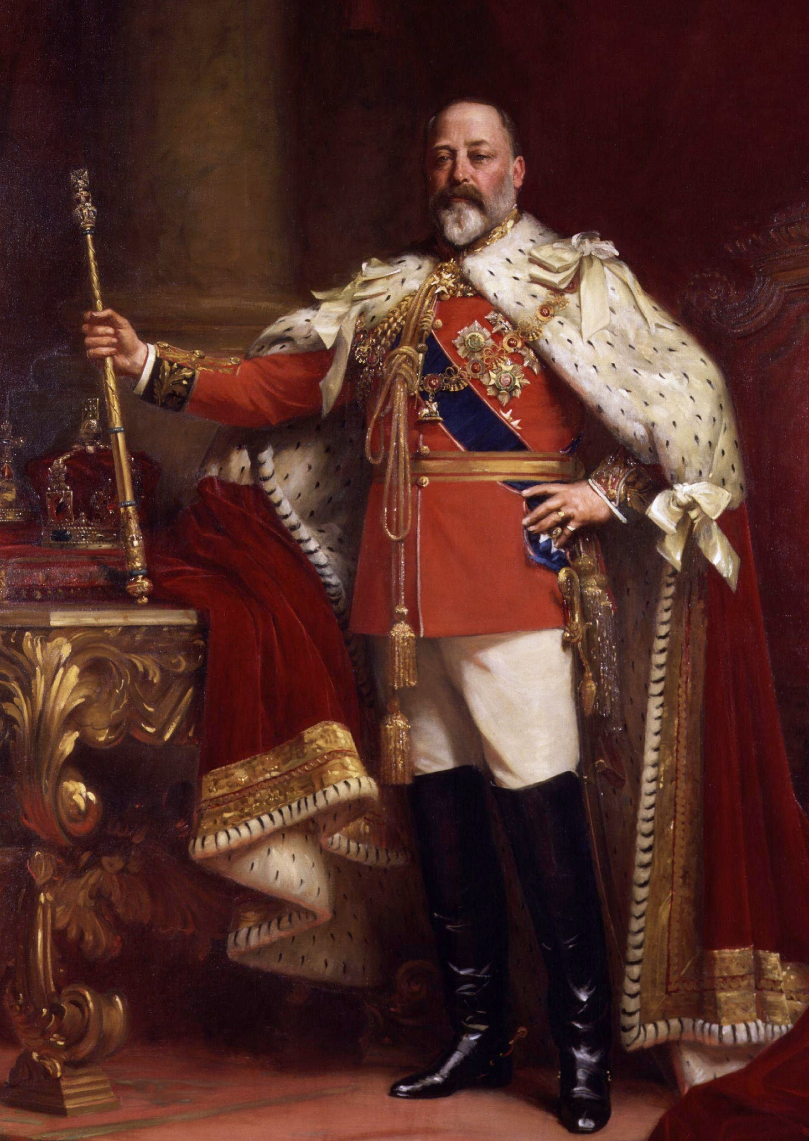
Notes:
Edward the Seventh was set to be crowned King of the United Kingdom and the coronation procession was scheduled for June 26 and 27 of 1902, in London.They really went all out with their procession in those days. They were epic.

Slide 11
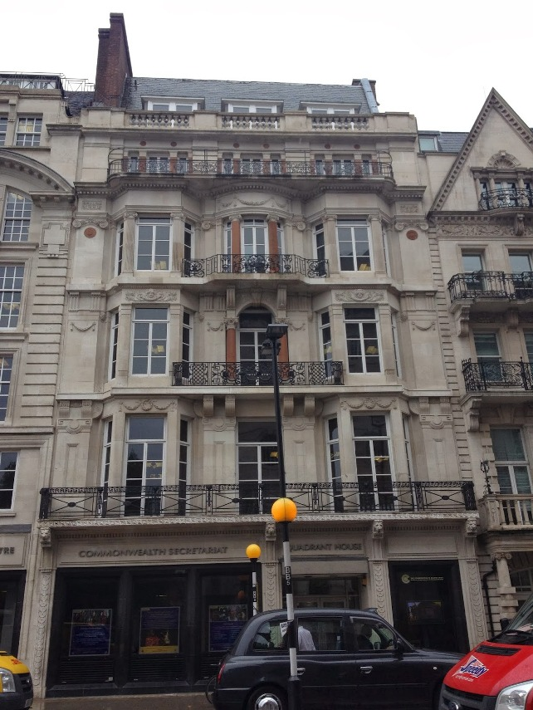
Notes:
A gentleman named Paul Krell owned a flat right along the procession route -- 56A Pall Mall, that’s it right there -- and another gentleman named CS Henry happened to be looking to rent a flat with a view of procession for both days of it. So Henry visited Krell’s flat, where the housekeeper informed him that it would indeed have an excellent view of the procession.

Slide 12
I am … inclosing [sic] form of agreement for the suite of chambers on the third floor at 56A, Pall Mall, which I have agreed to take for the two days, the 26th and 27th instant, for the sum of 75l … as arranged over the telephone I inclose [sic] herewith cheque for 25l. as deposit …
— CS Henry (June 20, 1902)
Notes:
Krell and Henry came to agreement over the phone. Henry send written confirmation along with a deposit.

Slide 13
I am in receipt of your letter of to-day's date inclosing [sic] cheque for 25l. deposit … and I confirm the agreement that you are to have the entire use of these rooms during the days …
— Paul Krell (June 20, 1902)
Notes:
Krell confirmed his receipt of those items as well as the agreement.

Slide 14
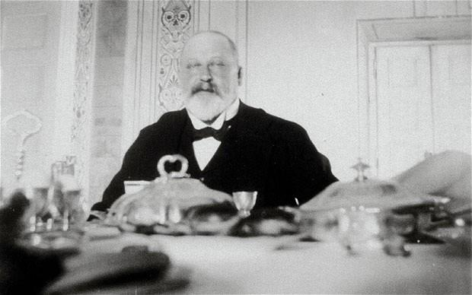
Notes:
And then poor old Edward the Seventh fell quite ill and the coronation was postponed indefinitely. Henry refused to pay the balance of the rental fee. Krell sued. And a court discharged the contract.

Slide 15
FRUSTRATION
OF
PURPOSE
Notes:
Why? They did so based on a doctrine called frustration of purpose. The idea here is that if unforeseen events occur that frustrate one party’s primary purpose in forming the contract, and both parties knew about that purpose at the outset, then the contract may be undone. We as a society prefer not to hold the parties to it.

Slide 16
RESCISSION
REFORMATION
TERMINATION
MODIFICATION
Notes:
Frustration of purpose is still a grounds for what is called rescission, which is the court ordered undoing of a contract, and is one of a set of implements that contract law uses to react to unforeseen eventualities.

Slide 17
Unforeseen Eventualities on Blockchain:
Network Failures
Notes:
On the blockchain, we can imagine all sorts of unforeseen eventualities. Network failures...

Slide 18
Unforeseen Eventualities on Blockchain:
Network Failures
Datafeed Failures
Notes:
Datafeed failures...

Slide 19
Unforeseen Eventualities on Blockchain:
Network Failures
Datafeed Failures
Coding Errors (EtherPot)
Notes:
Coding Errors discovered after the fact...

Slide 20
Unforeseen Eventualities on Blockchain:
Network Failures
Datafeed Failures
Coding Errors (EtherPot)
Changes of Heart
Notes:
..or the discovery of fraud after an agreement has been made. As we’ve just saw, contract law has the tools for such an intervention. The question is, how can we emulate these tools in smart contracts, espectially when one of the most appealing aspects of smart contracts, for some, is their immutability? On the technical level, there certainly some possibilities. These are things like:

Slide 21
Unforeseen Eventualities on Blockchain:
Network Failures
Datafeed Failures
Coding Errors (EtherPot)
Changes of Heart
Discovery of Fraud
Notes:
..or the discovery of fraud after an agreement has been made. As we’ve just saw, contract law has the tools for such an intervention. The question is, how can we emulate these tools in smart contracts, espectially when one of the most appealing aspects of smart contracts, for some, is their immutability? On the technical level, there certainly some possibilities. These are things like:

Slide 22
Possible Tools for Dealing with
Unforeseen Eventualities on Blockchain:
Native Tools (e.g. selfdestruct): in protocol
Notes:
So we want to think about how to deal with these situations. That includes technical solutions. These include protocol tools: functions for undoing or altering contracts that are built into the network architecture.

Slide 23
Possible Tools for Dealing with
Unforeseen Eventualities on Blockchain:
Native Tools (e.g. selfdestruct): in protocol
Prescient Coding:
Functions that can be turned on/off
Notes:
Prescient coding: creating functions that courts or parties can turn on or off in order to adapt to circumstances.

Slide 24
Possible Tools for Dealing with
Unforeseen Eventualities on Blockchain:
Native Tools (e.g. selfdestruct): in protocol
Prescient Coding:
Functions that can be turned on/off
Sockets for TBD dependent contracts
Notes:
And lastly, dynamic contract dependencies: webs of interactive contracts that can be scuttled or swapped out in response to unforeseen eventualities. Continuing to hone these potential tools and drawing from the lessons of contract law is the topic of a forthcoming IC3 paper and something I hope we’ll all be able to discuss here at the retreat and long afterward.

Slide 25

Bill Marino
Cornell Tech CS M.Eng. JD

Slide 26
Notes:
..or the discovery of criminal content after the fact. As we’ve just seen, contract law has the tools for such an intervention. The question is should or can we import those tools into smart contracts and how? The is the topic of a forthcoming IC3 paper and something I hope we’ll all be able to discuss here at the retreat and afterward.

